Slide 1
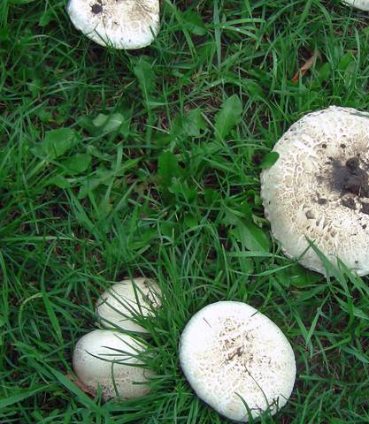
Group 4 IST 707 Mushroom Edibility Classification
Yu Sheng Lu , Jonathan Xiong, Joseph Maugeri
Poisonous or Edible?
Notes:
Joseph Maugeri

Slide 2
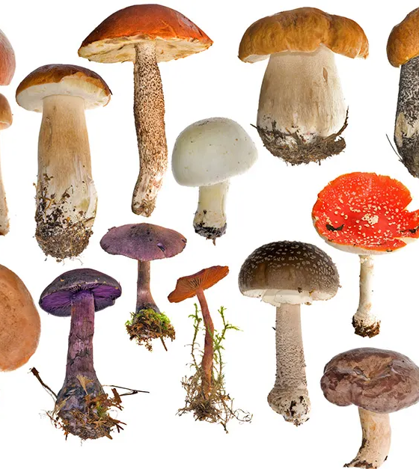
Defining Mushrooms
Let’s Introduce mushrooms overall;
“Mushrooms” are part of a highly varied collection of organisms known as the Fungi Kingdom
The “Mushroom” you see is the reproductive fruit of a larger organism
Mushroom’s fruit are usually only present for a few days, which makes them incredibly rare in the fossil record.
Most mushrooms have a stalk, and cap, but many other varieties occur globally.
Notes:
Joseph

Slide 3
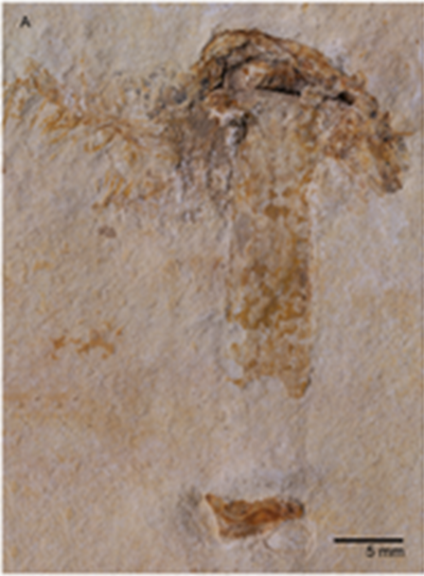
One of the Oldest Mushroom Fossils
Specimen shown right is found in Chapado de Agaripe , in Cerea Brazil.
Rare preservation in a “Lagerstätten”, a fossil rich deposit, dating 115 b.y.a. ( billion years ago)
Mushrooms do not fruit for more than a few days, so fossil records are sparse.
Many of the same features as modern mushrooms are present (Lamella, veil, stipe, and ring.)

Slide 4
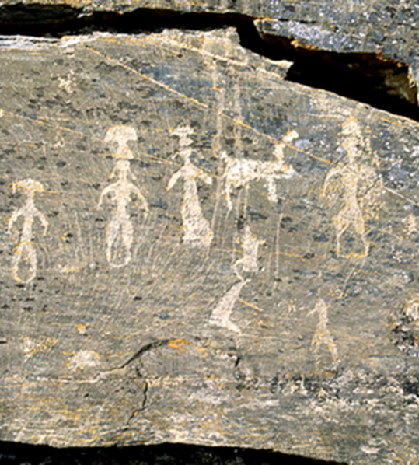

Ancient Humans & Mushrooms
Ethnomycology is the study of humankind’s usage and conception of mushrooms in culture throughout history.
(Left) Siberia 1. C.E. , Ancient whaling people depict Mushrooms on their heads from the Pegtymel Petrogylphs
Thought that psychoactive mushrooms were a ritualistic part of their culture
Notes:
Jon

Slide 5
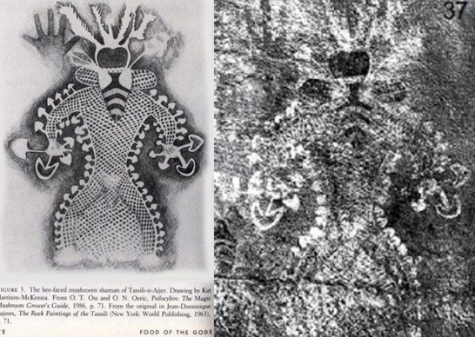
Ancient Humans & Mushrooms
Found at Tassili N’Ajjier, in Algeria, dating 9,000 – 7,000 years old.
Oldest Cave paintings depicting humans utilizing mushrooms in ritualistic ways

Slide 6
Early Civilizations
Romans termed mushrooms as “Food of the Gods”
Egyptians believed they grew by magic due to fast growth rate
Galen documented Ancient Chinese cultivating what are thought to be Shitake Mushrooms in his notebook
Many Native American groups that practiced foraging would use mushrooms for medicinal and spiritual reasons.

Slide 7
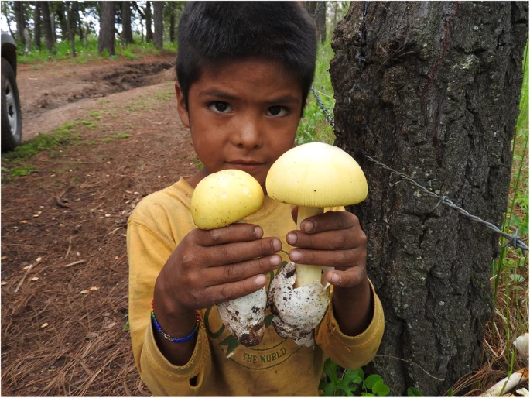
Continued foraging through modern times
Ethnomycologist study the foraging patterns of many ethnic groups across the globe today.
Little to no documentation on the foraging patterns and various species of mushrooms across groups
Knowledge runs the risk of being lost due to the fading of traditional practices

Slide 8
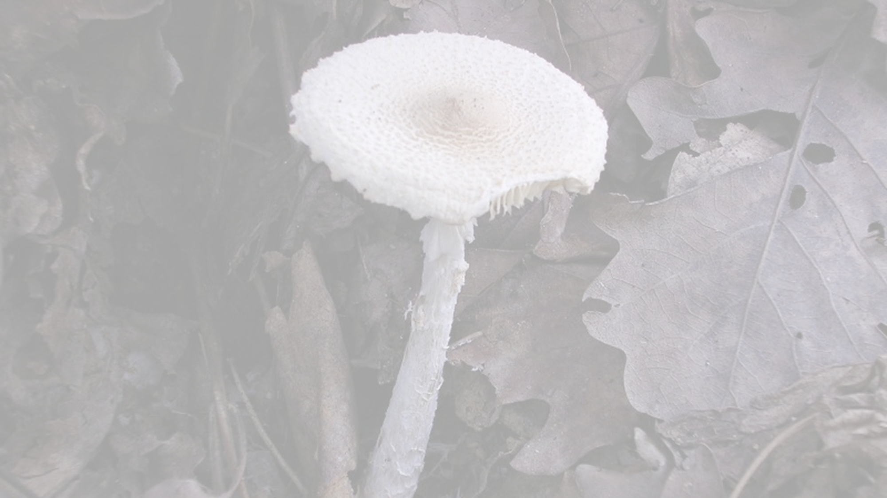
Certainty of Identification
Proper identification is dependent on comprehensive species AND ecosystem knowledge
Each area where mushrooms grow is a unique ecosystem that many house several species
Many times, traditional foraging methods found in specific ethnic groups must be relied on in the scientific community.

Slide 9
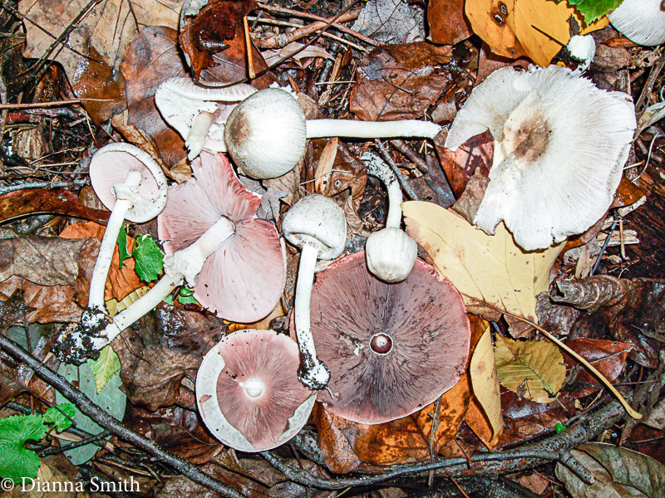
Agaricaceae Family of Mushrooms (ex. 1)
One example of species from genus agaricus, species abruptibulbus, shown right.
All agaricus species have a partial veil, which leaves behind a ring
Enjoy moist dark areas, wood piles, manure, and decomposing logs

Slide 10
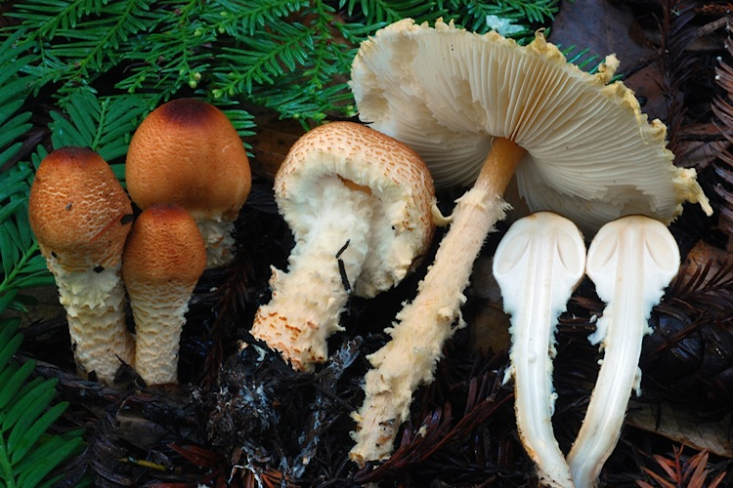
Agaricaceae Family of Mushrooms (ex. 2)
Several stages in development of Lepiota magnispora shown right.
All Lepiota have a partial veil, never forming a full veil
Grow in soils rich in carbonate and biomass litter

Slide 11
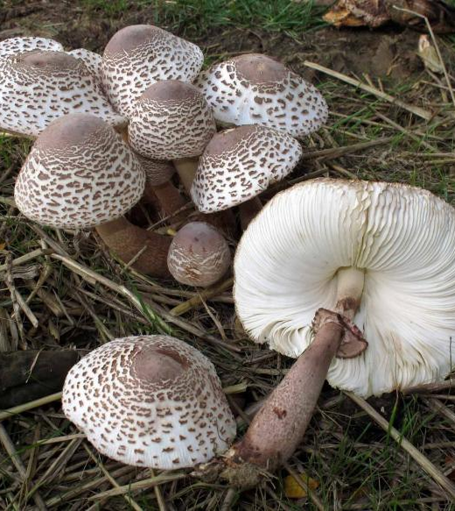
Exploring Agaricaceae
Within both Lepiota and Agaricus genus, there are known mushrooms that are poisonous or edible.
If growing conditions, discrete physical features, spread, and spore print are known, Is it possible to separate this family of mushrooms into a poisonous or edible category?

Slide 12
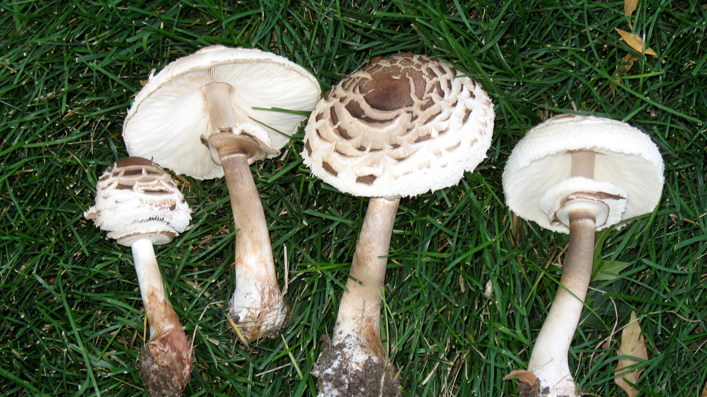
Data Context
Data is on 23 species of Lepiota and Agaricus genus of family Agaricaceae mushrooms ( no species category is provided with the data)
Of the 22 features, some are (bruises?, odor, stalk-shape, gill-attachment, spore-print-color, population, and habitat)
All 22 features are coded as single letters representing a category of the feature.
There is no missing / NA information in the 8125 rows of data
Training and testing splits were done on every 4 indexes
The data was acquired from https://www.kaggle.com/datasets/uciml/mushroom-classification?resource=download

Slide 13
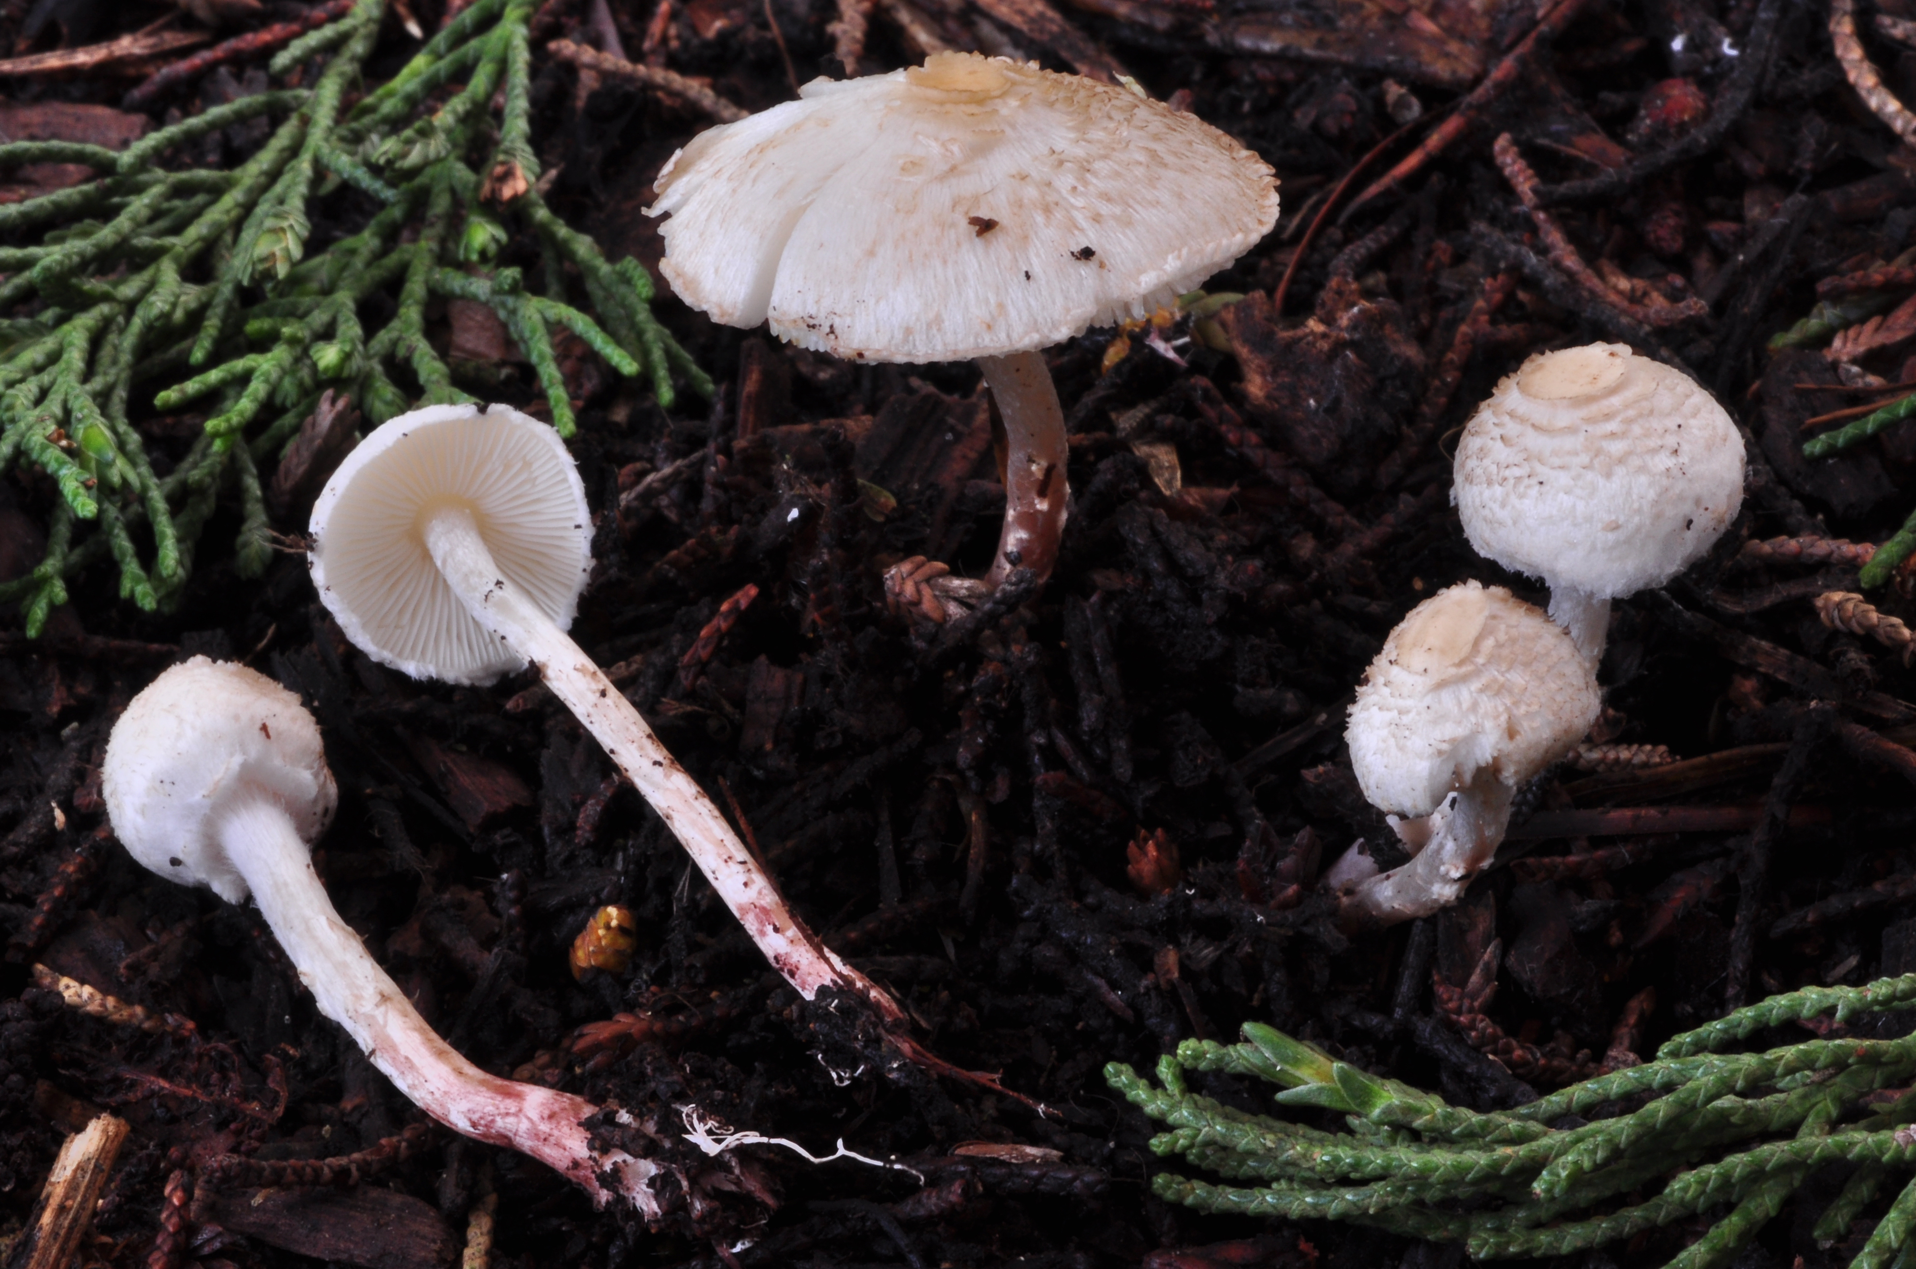
Exploratory Analysis

Slide 14
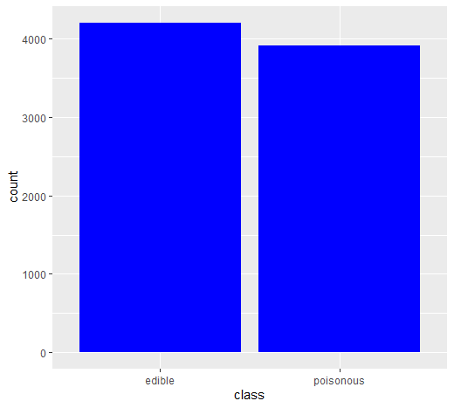
Distribution of Class
Of the 8125 instances, there are close to an even split of poisonous and edible mushrooms

Slide 15
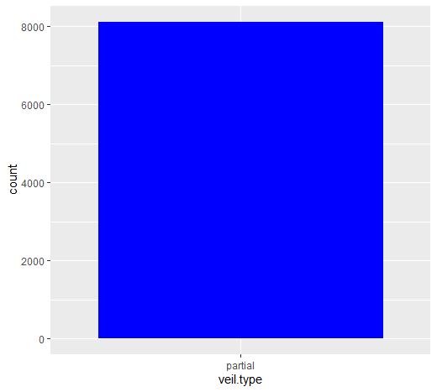
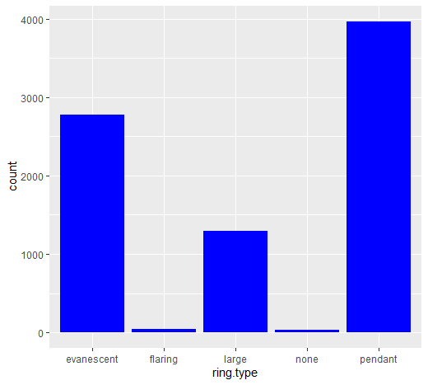
Example of Imbalanced Features (ex.1)

Slide 16
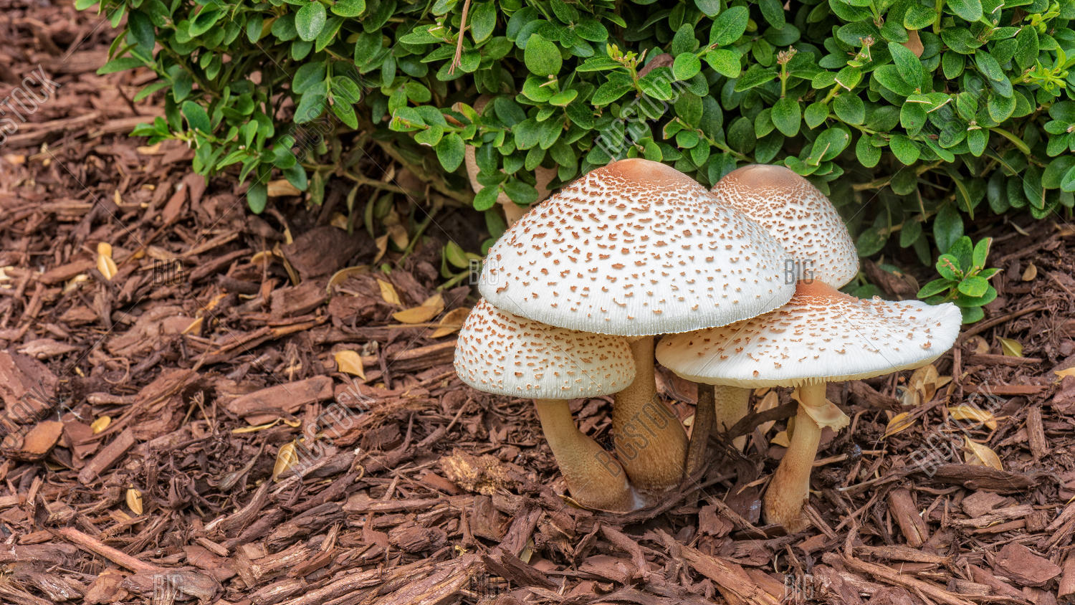
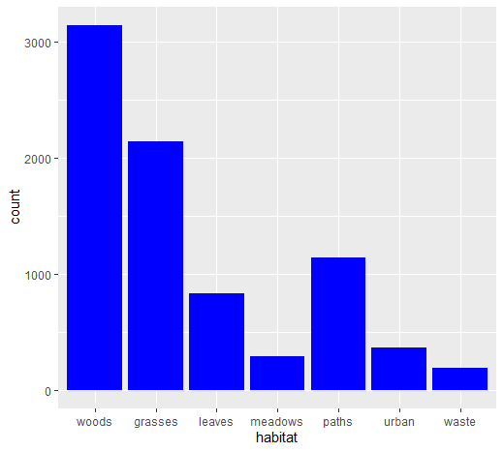
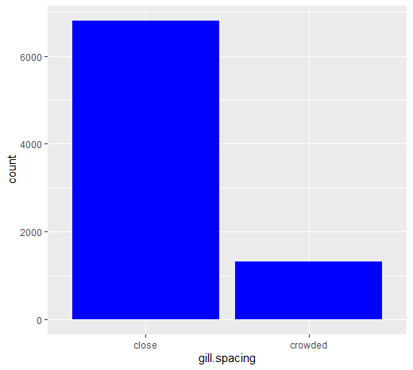
Example of Imbalanced Features (ex.2)

Slide 17
Applying Classification / Data Mining Techniques

Slide 18
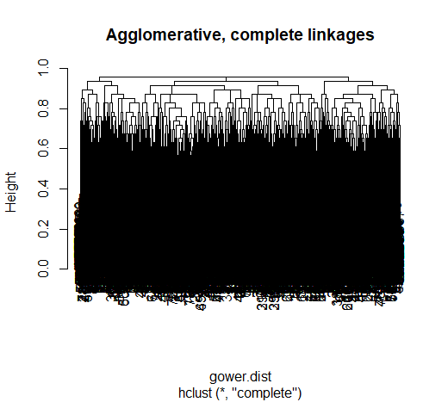
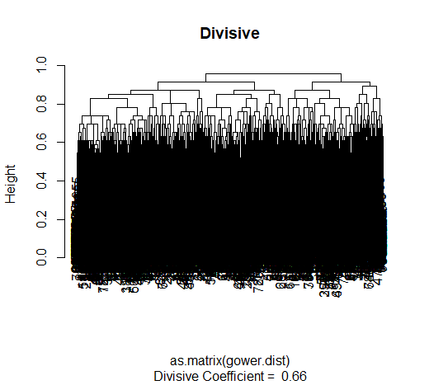
Applying Hierarchical Clustering
Given all are categorical variables, neither complete or divisive methods worked

Slide 19
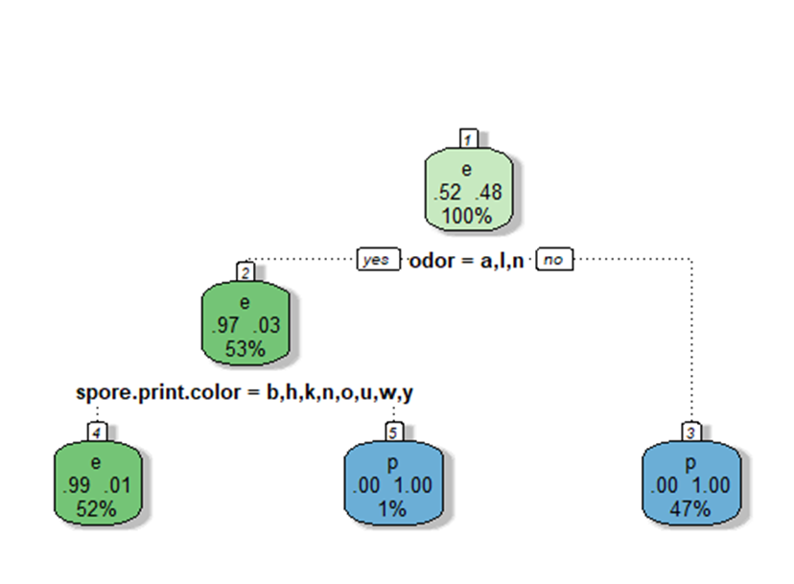
Applying Classification Techniques : Decision Tree
Incredibly effective at classifying poisonous and edible class within the Agaricaceae Family ( Both Lepiota and Agaricus ).
Despite this, misclassification occurs on a handful of poisonous members, seen by impure nodes.
The cost of following a wrong decision based on this model could still be fatal.

Slide 20
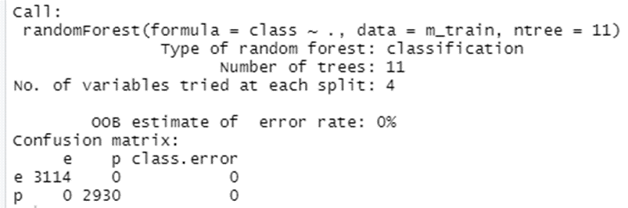
Applying Classification Techniques : Random Forest
Iterating over the Decision Tree method ntree =11 ,m which corrected error found in one tree.
100% accuracy was achieved in testing and training through viewing the confusion matrix.
This is only for this family of mushrooms, and this model is likely only applicable to some of the other genus within Agaricaceae

Slide 21
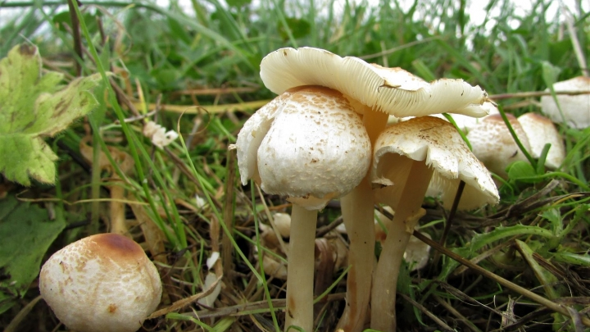

Association Rule Mining
Top 10 of 98 rules generated with no target, for understanding general feature association.
Support = 0.30 , confidence = 0.90, maxlen = 5

Slide 22
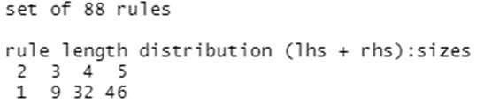
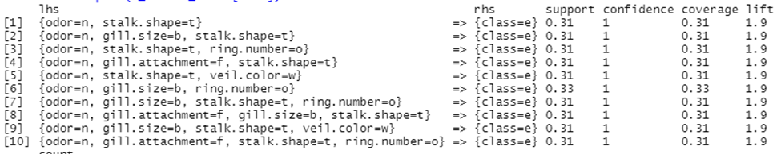
Association Rule Mining
Top 10 rules (of 88) Targeting class = edible ( e ) on the Right-hand-side
Support = 0.30 , confidence = 0.90, maxlen = 5

Slide 23
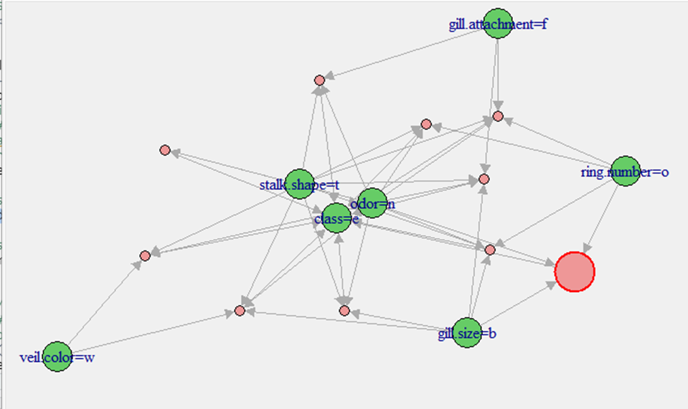
Association Rule Mining
Top 10 rules (of 88) Targeting class = edible ( e ) on the Right-hand-side Support = 0.30 , confidence = 0.90, maxlen = 5

Slide 24
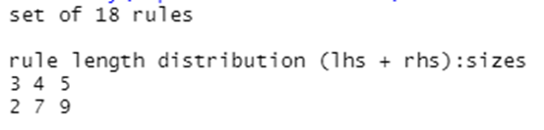
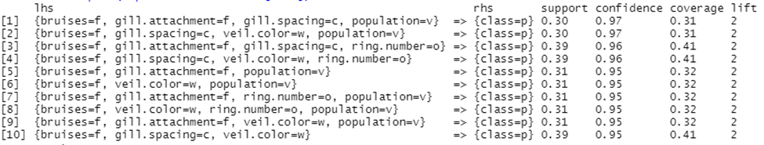
Association Rule Mining
Top 10 rules (of 18) Targeting class = edible ( p ) on the Right-hand-side
Support = 0.30 , confidence = 0.90, maxlen = 5

Slide 25
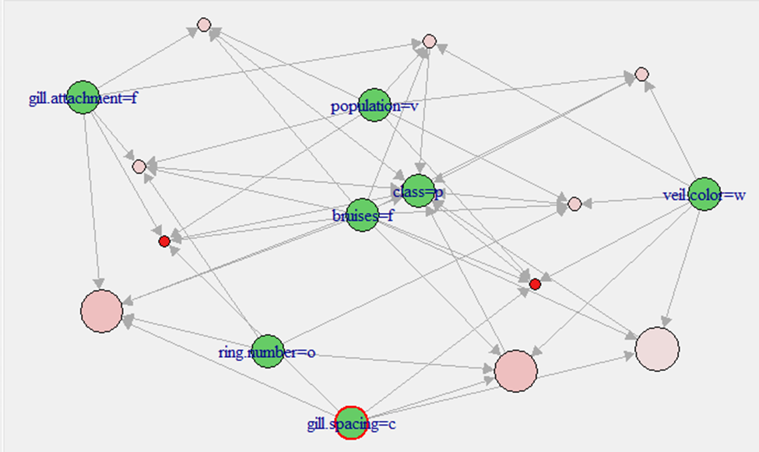
Association Rule Mining
Top 10 rules (of 18) Targeting class = edible ( p ) on the Right-hand-side
Support = 0.30 , confidence = 0.90, maxlen = 5

Slide 26
Comparison of Techniques
Using both classification and association rule mining revealed significant features with respect to not only class of mushroom, but the family examined.
While decision tree found odor = a, l, or n to be highly significant, association rule mining found poisonous mushrooms almost always have bruises = f
Commonalities were revealed between poisonous and edible mushrooms for the Agaricaceae family, ( ring.number= o, and veil.type = p , gill.attachment = f )

Slide 27
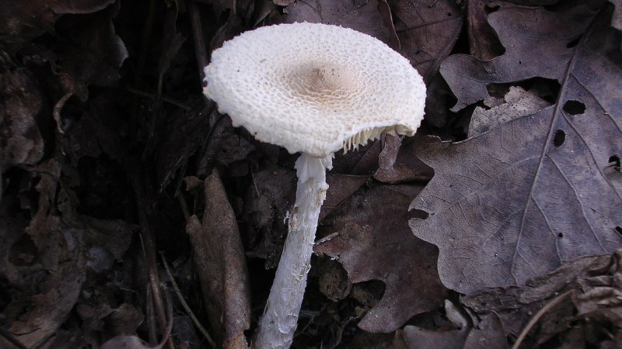
Contextualizing Results
Reviewing the high accuracy generated, we suspect that this model is really only applicable to these two genus of mushrooms.
Its likely decreased effectiveness will occur even applying models to other genus within family Agaricaceae.
Since genus are separated on some aspect of their features or behavior, any work done to classify here will be unknowledgeable to new relationships
Even further decrease in effectiveness if the model was generalized to other families of mushrooms.

Slide 28
Conclusion
General information available on mushrooms is sparse and not equal across all ecosystems on the planet, with new species being discovered continuously.
Scientists must be careful applying classification techniques, as without comprehensive knowledge of all mushrooms in any given area, there is just so much that is not known.
Preservation of traditional knowledge across the globe will be key to understanding the fungi kingdom, and humanities expansive history on the planet with them.

Slide 29
Thank you
Questions?

Slide 30
Images Used
Images used in powerpoint
Agaricus Bisporus (Slide 1)
https://candide.com/img/39f5dd34-6b60-4444-b419-d939d3b00c6a/cropped/600x480
(Inserted ) Slide 2
https://i0.wp.com/curejoy.com/wp-content/uploads/2017/02/Poisonous-Mushrooms-You-Should-Stay-Away-From.jpg?fit=1200%2C627&ssl=1
Lepiota racchodes (Slide 2)
http://urbanmushrooms.com/images/18.jpg
Slide 3 Reddening Lepiota
https://static3.bigstockphoto.com/0/0/2/large1500/200331292.jpg
Slide 4 Stinking Dapperling
https://www.wildfooduk.com/wp-content/uploads/2019/10/Cristata-9-1-720x540.jpg
Lepiota Scarabulla (Slide 5)
http://iucn.ekoo.se/assets/uploads/d3c7b-Lepiota-scaberula_SFWatershed_6-Dec-2014_NS.jpg
Agaricus Agruptabulbus (Slide 6)
https://www.fungikingdom.net/_Media/agaricus--abruptibulbus1066_med_hr.jpeg
Lepiota Clypeolaria (Slide 8)
https://upload.wikimedia.org/wikipedia/commons/5/5b/Lepiota_clypeolaria.JPG
Notes and Resources on Mushrooms
Speciation in fungi
https://academic.oup.com/bioscience/article/49/6/440/229441

